Slide 1
Computer Network Protocols: Introduction

Slide 2
Textbooks
Tannenbaum, A.S. – “COMPUTER NETWORKS”, Prentice Hall of India [EE Edition], 5th edition, 2013.
Alberto Leon Garcia – “Communication Networks”, Tata McGraw Hill, 2nd edition, 2004
Behrouz A. Forouzan – “TCP/IP PROTOCOL SUITE”, Tata McGraw Hill, 4th Edition, 2017
Behrouz A. Forouzan – “Data Communication and Networking”, Tata McGraw Hill, 5th Edition, 2013

Slide 3
Course Objectives
CO1: To understand the organization of computer networks, factors influencing computer network development and the reasons for having variety of different types of networks.
CO2: To contrast the protocol architectures such as OSI and TCP/IP.
CO3: To demonstrate proper placement of different layers of ISO model and highlight its function.
CO4: To determine proper usage of the IP address, subnet masks and default gateway in a routed network.
CO5: To understand internals of main protocols such as TCP, UDP and IP, analyze simple protocols and independently study literature concerning computer networks.

Slide 4
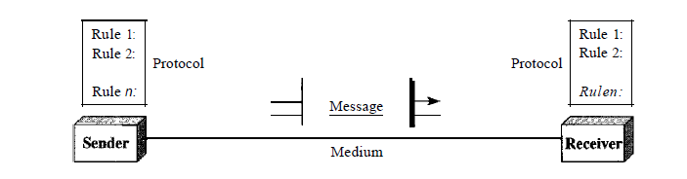
Basics
What is Computer Networks?
Components of Computer Network?
Internet vs internet(or internetwork)
Notes:
Computer Networks: Computer network is a communication network in which a collection of computers are connected together to facilitate data exchange.

Slide 5
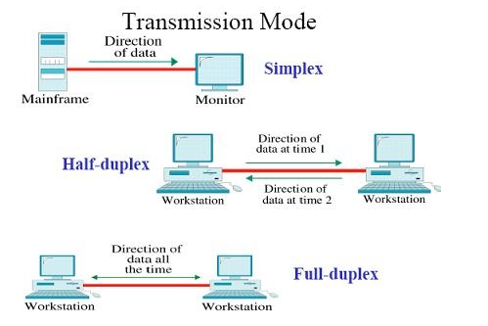
Data Flow
Communication between two devices can be :
Simplex
Half-duplex
Full duplex

Slide 6
Basics: Network Criteria
Performance
Transit Time, Response Time
#Users, Type of transmission Medium, Capabilities of connected hardware, efficiency of software
Throughput, Delay
Reliability
Accuracy of delivery.
Frequency of failure, time to recover from a failure, and network’s robustness.
Security
CIA

Slide 7
Basics: Network Topologies
Topology
Mesh
Star
Bus
Ring

Slide 8
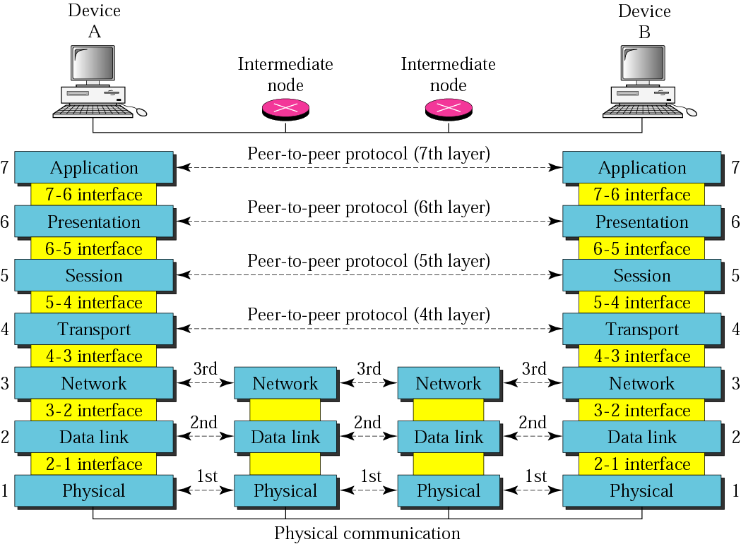
Basics: OSI Model and Layers
Layers
Protocols
Interfaces
Services

Slide 9
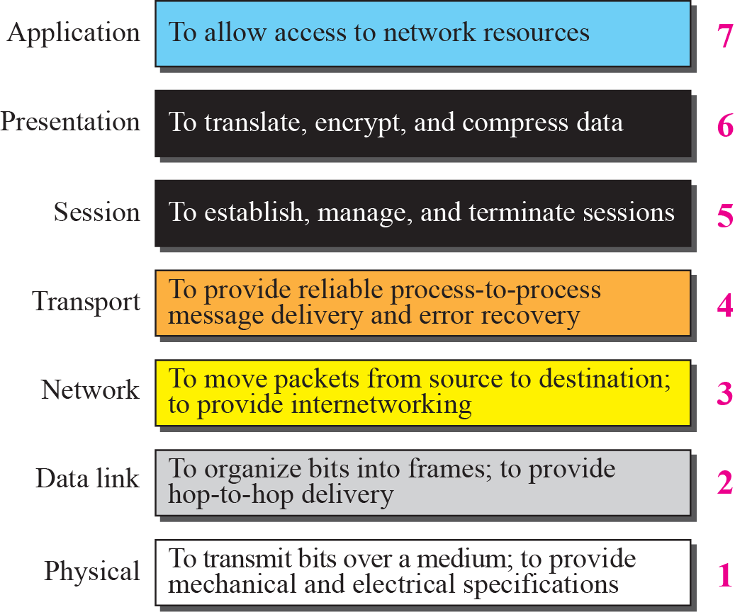
Figure 2.6 Summary of OSI Layers

Slide 10
Basics: Protocol
A protocol is an agreement between the communicating parties on how communication is to proceed.
It defines:
what is communicated,
how it is communicated, and
when it is communicated.
Layer n protocol.

Slide 11
Basics: Interfaces and Services
Interface: interaction between layers(request a service and convey results)
Defines which primitive operations and services the lower layer makes available to the upper one.
The abstraction at the layers is possible through a clearly defined service and interface.
Services: Set of primitives (operations) that a layer provides to the layer above it.
Connection-oriented vs Connectionless service.

